Slide 1
ShadowPayloads: Obfuscation Techniques and Evasion Strategies in Malware
Submitted in the partial fulfillment for the award of the degree of
BACHELOR OF ENGINEERING
IN
CSE(INFORMATION SECURITY)
Submitted by:
ROBERT (22BIS50001)
Vartika (22BIS70108)
Under the Supervision of:
SHEETAL LAROIYA
Department of AIT-CSE
DISCOVER . LEARN . EMPOWER

Slide 2
Outline
Introduction
Objective
Methodology
Results and Outcome
Conclusion

Slide 3
Introduction:
Modern malware often hides its malicious code using obfuscation, making detection harder.
Obfuscation can involve encoding, compression, packing, or control-flow tricks.
Traditional tools like strings or static scanners, VirusTotal, brub Suite collaborator may fail to reveal the hidden parts.
Understanding how obfuscation works is important for building stronger analysis methods.

Slide 4
Objective
To study and simulate common obfuscation techniques (e.g., Base64, XOR, compression, splitting).
To analyze their effect on static and dynamic analysis tools in a controlled, harmless environment.
To measure detectability, decoding effort, and analyst time across different techniques.
To propose strategies and recommendations for improving visibility into hidden payloads.

Slide 5
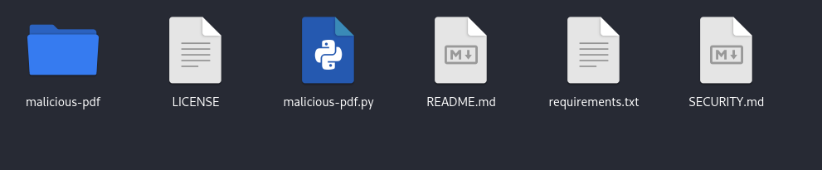
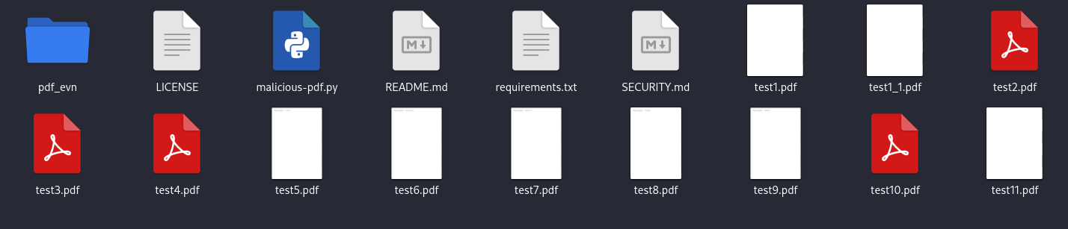
Methodology used
Objective:
  To safely analyze and classify obfuscated PDF-based malware (Trojan type).
  Defensive, research-only methodology ensuring zero weaponization.

Slide 6
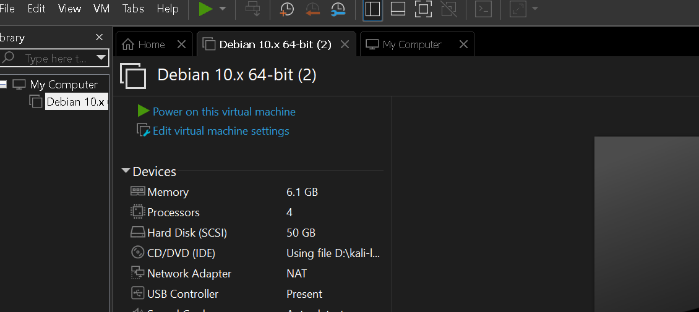
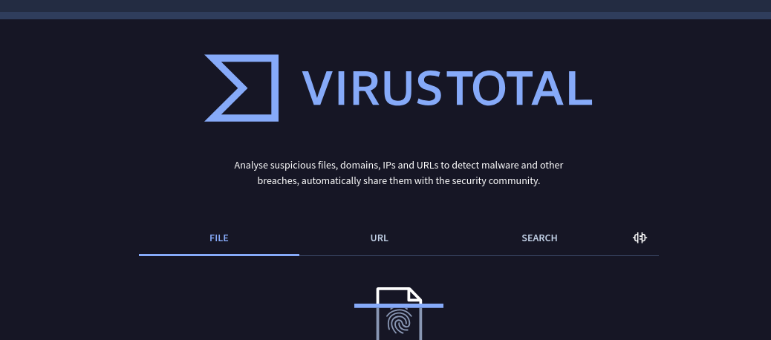
Methodology used
Approach:
  Defensive, research-only methodology ensuring zero weaponization.
  Analysis conducted in isolated, sandboxed environments under controlled settings.
  All payloads handled ethically — no execution on production systems.

Slide 7
Methodology used
Dynamic / Behavioral analysis:
Instrumented sandbox environments (air-gapped VMs) with monitoring: API-call logging, filesystem monitoring, process tracing, and controlled network sink. Example frameworks used: an internal instrumented reader harness or community sandboxes configured for research (e.g., Cuckoo-like orchestration).
Network simulators / controlled sinks to observe connection attempts without contacting external infrastructure.
Host telemetry collectors: process/event logs, file system watchers, and memory snapshot tools (used only for high-level behavioral metrics; raw memory dumps were not published).
Correlation & external services:
VirusTotal and other multi-engine correlation platforms for detection ratios and classification tags (screenshots and aggregate counts only; no raw artifact sharing).
Threat intelligence feeds for contextual mapping (only high-level attribution/label data retained).

Slide 8
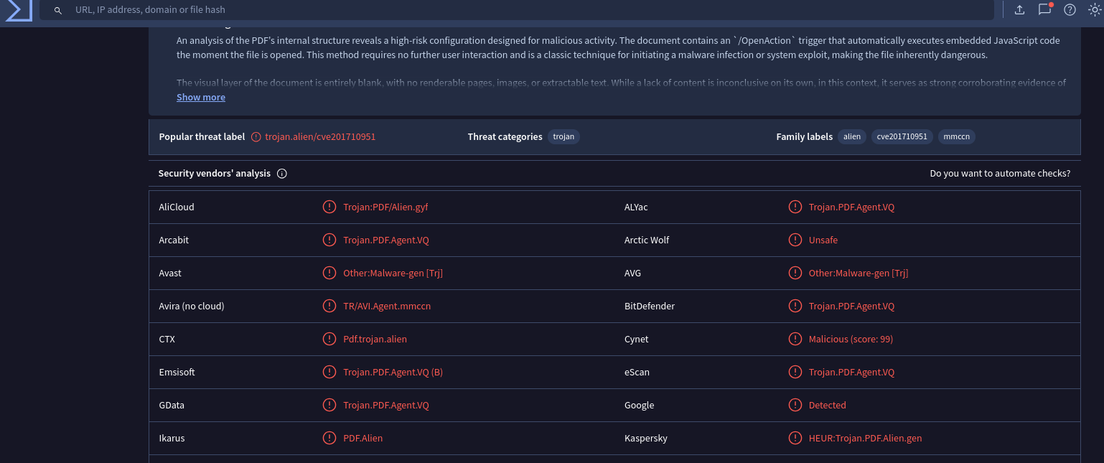
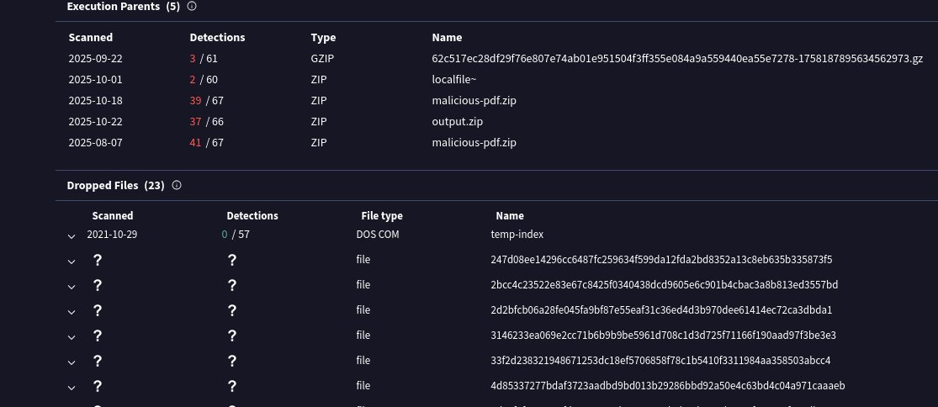
Results and Outcome

Slide 9
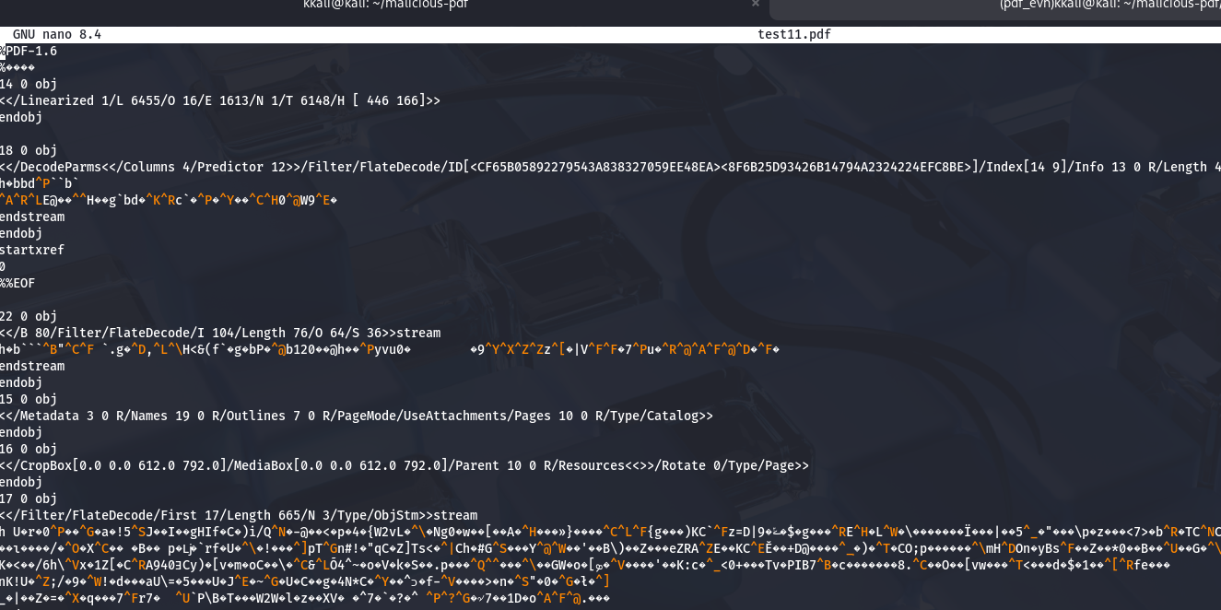
Results and Outputs

Slide 10
Thankyou

